Slide 1
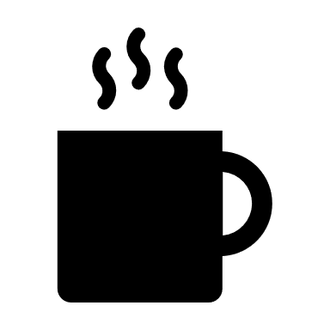
Starbucks Market Analysis “Jersey Style”
Brought to you by the DATA Gurus

Slide 2


Analysis Team
Ritu Mishra- Programming leader (Google API, Pandas, Matplotlib)
Pablo Albilal- Programming Leader (Census API, Pandas, Plot.ly, QGIS, Google Maps Engine)
Tim Denny- Project Coordinator (PowerPoint, Research, basic Pandas)
Seth Porter- Project Coordinator (PowerPoint, Research, basic Pandas)

Slide 3

The Gurus want to know what’s brewing in New Jersey
Guru Data Tools
Census Data API
Jupyter Notebook
Python, Pandas, Matplotlib, Plot.ly
Microsoft Excel, Photoshop
Google API, QGIS, Google Maps Engine
247 Starbucks locations throughout the state.
Analyze the demographics for each location
Identify trends
Nearby competition

Slide 4
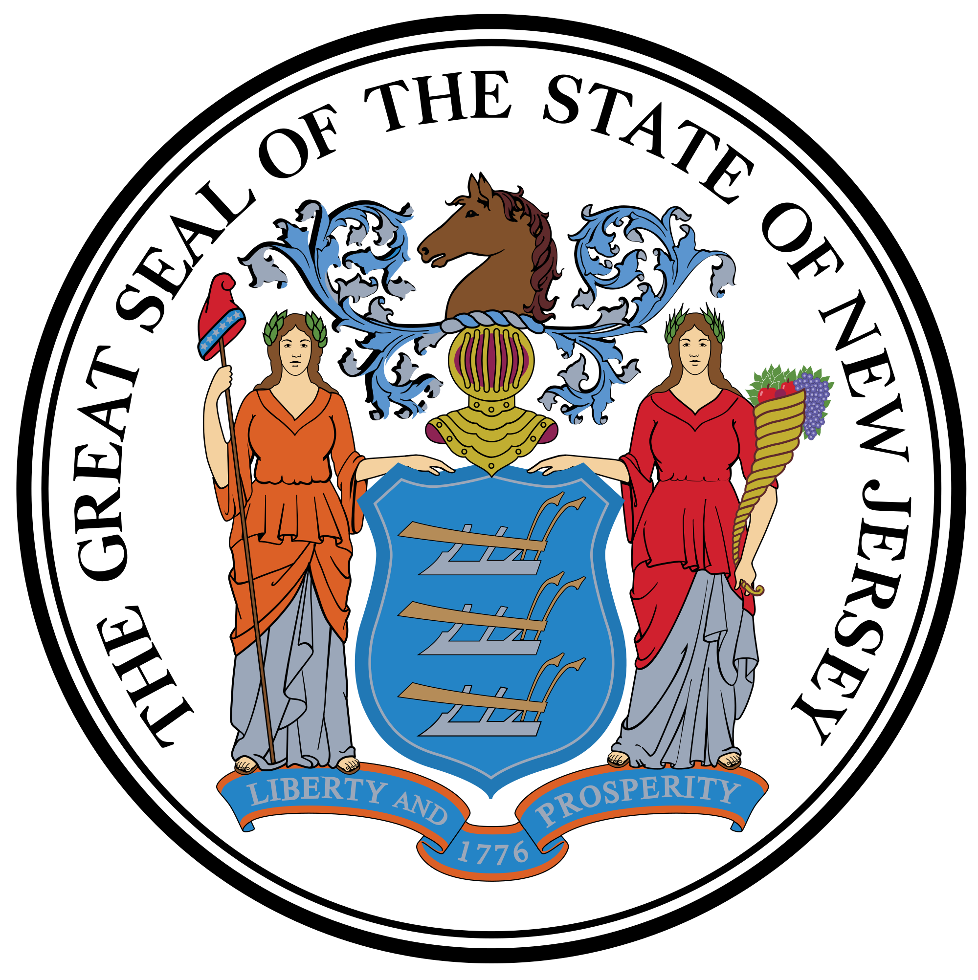
New Jersey Demographics
Total Population – 9 million
Median Household - $71,637
Median Age: 39
68% White, 14% Black, 8% Asian, 3% Multicultural, 6% Other
51% Female, 49% Male

Slide 5
Demographic Details for top 20 Cities With the Most Starbucks

Slide 7
OUTLIERS
Newark
Jersey City
Atlantic City
They are heavily populated with low incomes but do to demand caused by businesses, major transit centers, and tourism there are a significant amount of Starbucks

Slide 8
Location Types Department Store Hospital Shopping Centers/ Stand Alone Airports Grocery Stores Hotels Trains Stations Casino Highway Rest Area Mall University

Slide 9
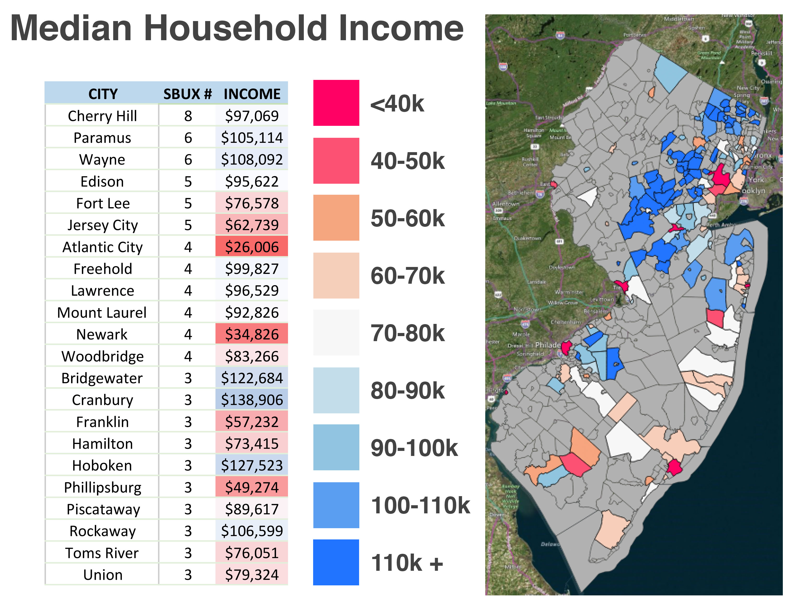
New Jersey
Demographics

Slide 10
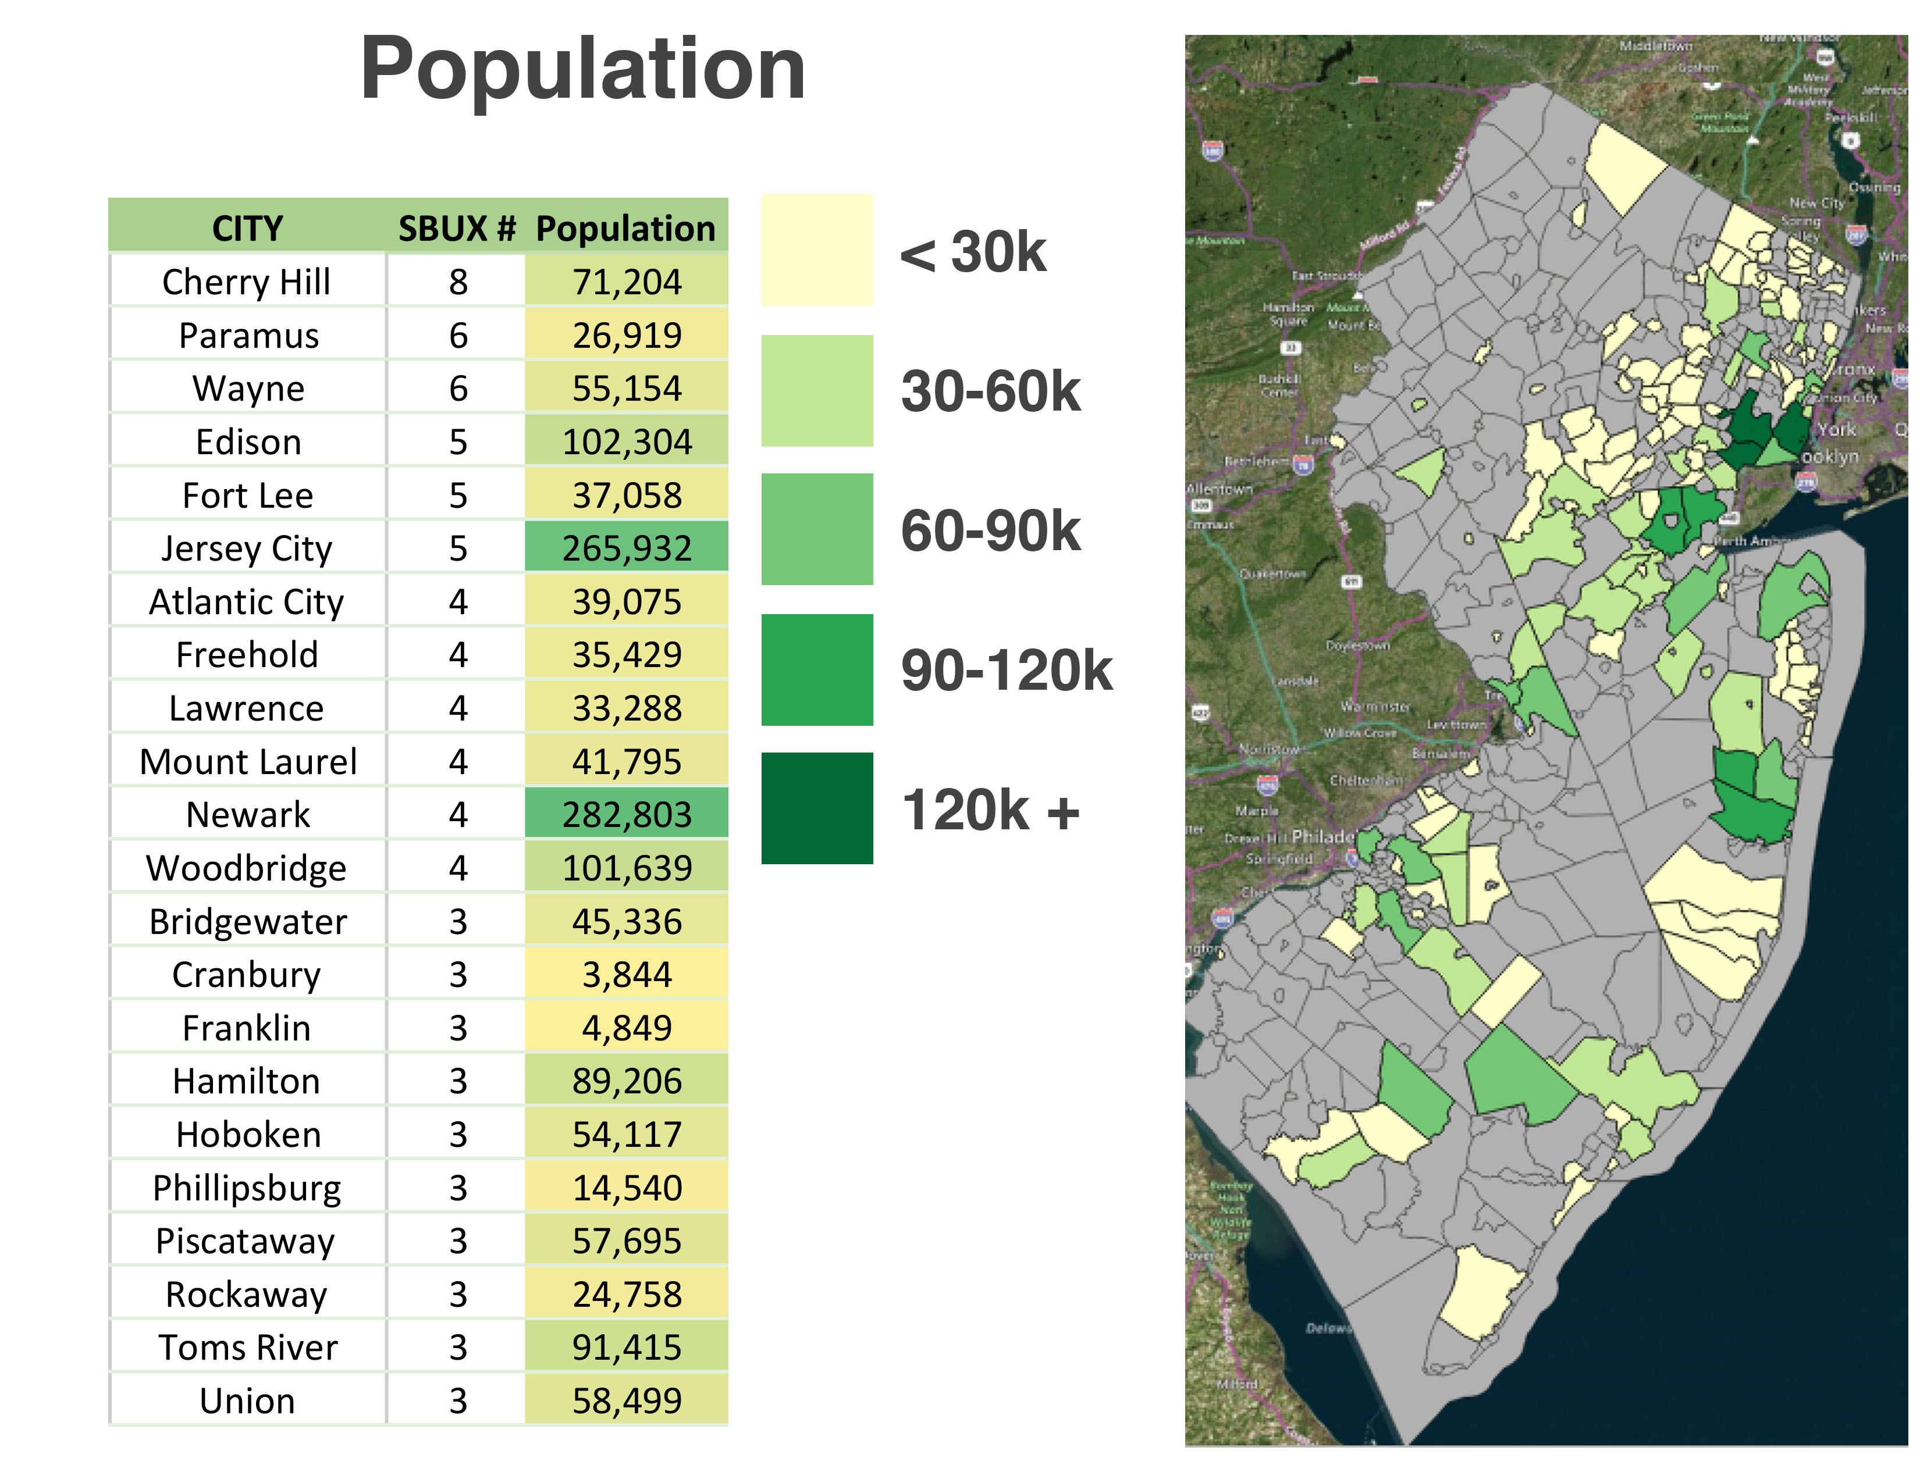
New Jersey
Demographics

Slide 11

Number of Starbucks with .5 miles of a train station (North/Central Jersey)

Slide 12
Number of Starbucks with .5 miles of a train station (South Jersey)

Slide 14




Type | Income | Population | Median Age | Count
Hospital | 92,296 | 18,833 | 36 | 1
Airport | 34,826 | 282,803 | 36 | 2
Hotel | 86,511 | 55,869 | 45 | 2
Train Station | 130,308 | 19,547 | 45 | 2
Casino | 26,006 | 39,075 | 42 | 3
University | 64,919 | 88,903 | 35 | 8
Grocery Store | 95,419 | 30,370 | 46 | 18
Highway Rest Area | 79,045 | 35,914 | 43 | 18
Mall | 97,980 | 58,841 | 45 | 25
Department Store | 84,451 | 40,665 | 44 | 32
Shopping Centers/ StandAlone | 100,457 | 36,383 | 44 | 136

Slide 15
Let’s Look at the Competition

Slide 17
Competition Analysis
The majority of the Starbucks competition is located in Barnes & Noble
Barnes & Noble sells Starbucks so they eliminated a major competitor as in Barnes & Noble
Second highest competition is Panera Bread

Slide 18
Analysis
34% of NJ Starbucks are located in 20 highest income cities
Majority of Starbucks are within .5 miles of Train station
Starbucks clusters around Philly and New York greater metropolitan areas (High working populations)
Also in wealthy suburban bedroom communities
Majority of Starbucks in Shopping Centers

Slide 19

Questions:

